Slide 1
Book1
File created on: 21-03-2023 22:18:44

Slide 2


Slide 3


Slide 4
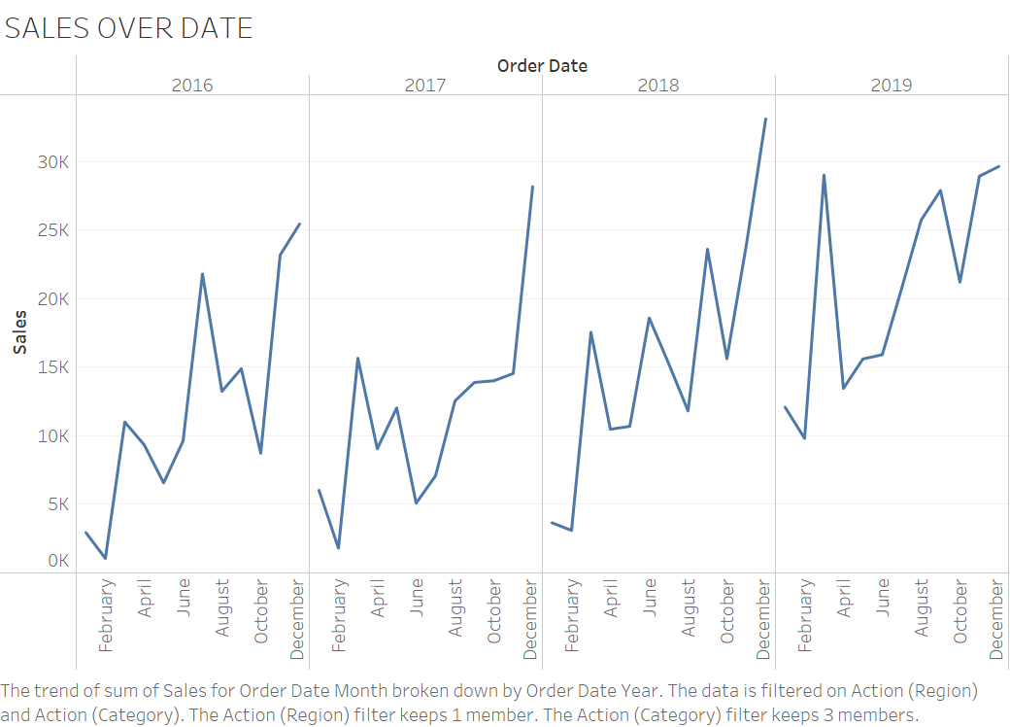

Slide 5
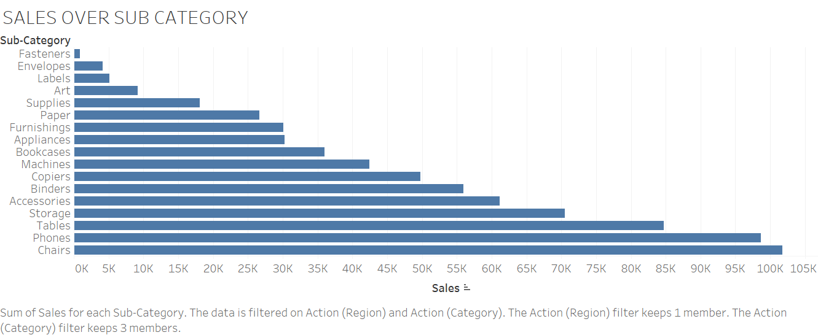

Slide 6
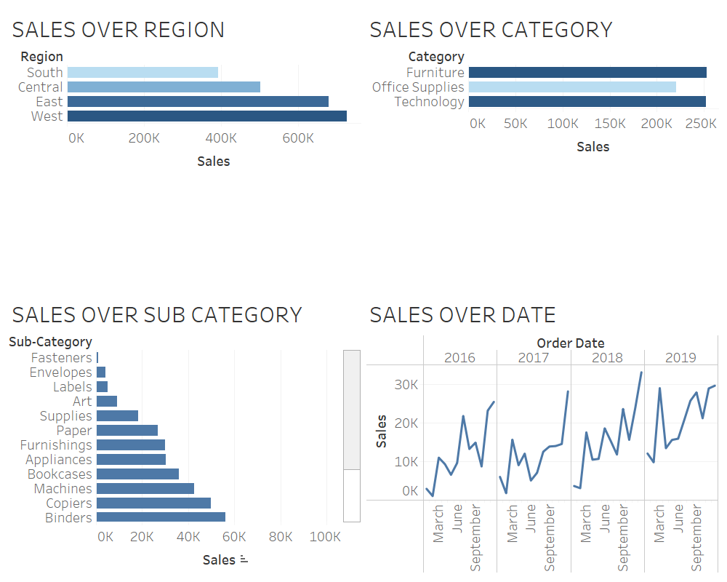

Slide 7
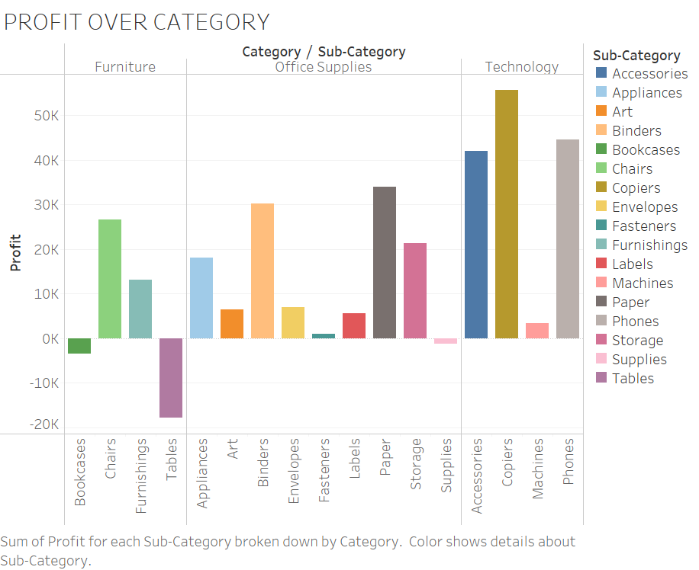

Slide 8


